Slide 1

The Rise of Agentic AI
Exploring autonomous intelligence that acts and learns to achieve its goals.

Slide 2
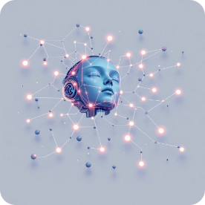
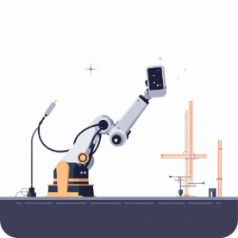
Understanding Agentic AI: Beyond Generative
Agentic AI represents a significant leap in artificial intelligence, moving beyond mere content creation to autonomous action.
Creative Machines
Autonomous Actions
Generating art, music, and stories.
Making decisions and executing tasks independently.
Generative AI:
Focuses on creating new content, such as text, images, or code, based on learned patterns and prompts.
Agentic AI:
An AI that can perceive its environment, make decisions, and take actions to achieve specific goals, often with minimal human oversight.

Slide 3

Daily Encounters with Autonomous Intelligence
Agentic AI is already integrated into our daily lives, often operating subtly in the background to enhance convenience and efficiency.
Self-Driving Cars
AI Assistants
Robotic Vacuum Cleaners
Navigating roads, detecting obstacles, and making real-time driving decisions without human intervention.
Scheduling appointments, managing smart home devices, and responding to complex commands autonomously.
Mapping homes, avoiding obstacles, and cleaning on schedules without direct user guidance.
Have you used any technology that acted on its own without human instruction?

Slide 4
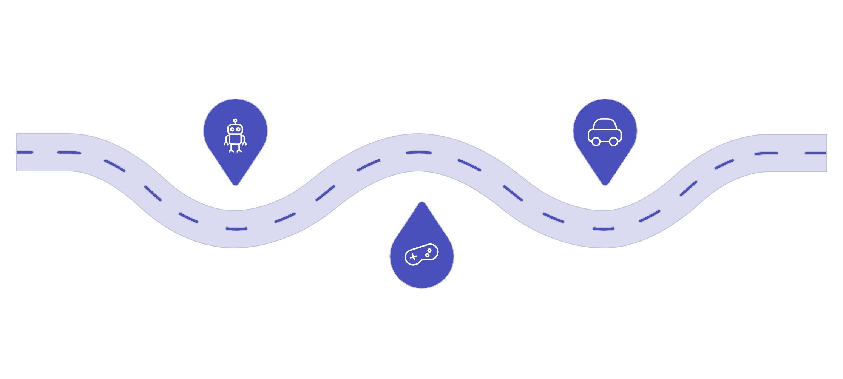
A Journey Through Time: Evolution of Agentic AI
Shakey
Tesla Autopilot
Early mobile robot from the 1960s
Production autonomous driving system
AlphaGo
Deep learning beats human Go champion
From rudimentary laboratory robots to sophisticated learning machines, Agentic AI has evolved dramatically, driven by breakthroughs in computing power and algorithmic design.
1960s: Early AI Agents
Simple robots like Shakey the Robot demonstrate basic perception and planning in controlled environments.
2000s: AI in Games
AI masters complex games like chess and Go, with Deep Blue and later AlphaGo achieving superhuman performance.
2010s: Reinforcement Learning
Advances enable AI to learn from trial and error, optimizing behaviors in dynamic environments.
2020s: Real-World Autonomy
Emergence of self-driving cars (Tesla Autopilot, Waymo), autonomous drones, and AI trading bots.

Slide 5

The Autonomous Loop: How Agentic AI Works
Goal Understanding
Planning
Action Execution
Learning
Agentic AI operates through a continuous feedback loop, allowing it to adapt and improve its performance over time.
01
02
Goal Understanding
Planning
The AI interprets its given objective (e.g., "deliver package safely") and the current state of its environment.
It assesses various potential actions and sequences to determine the most effective path toward achieving the goal.
03
04
Action Execution
Learning
The AI performs the selected actions within its operating environment.
Based on the outcomes of its actions, the AI refines its strategy, improving future decision-making.

Slide 6
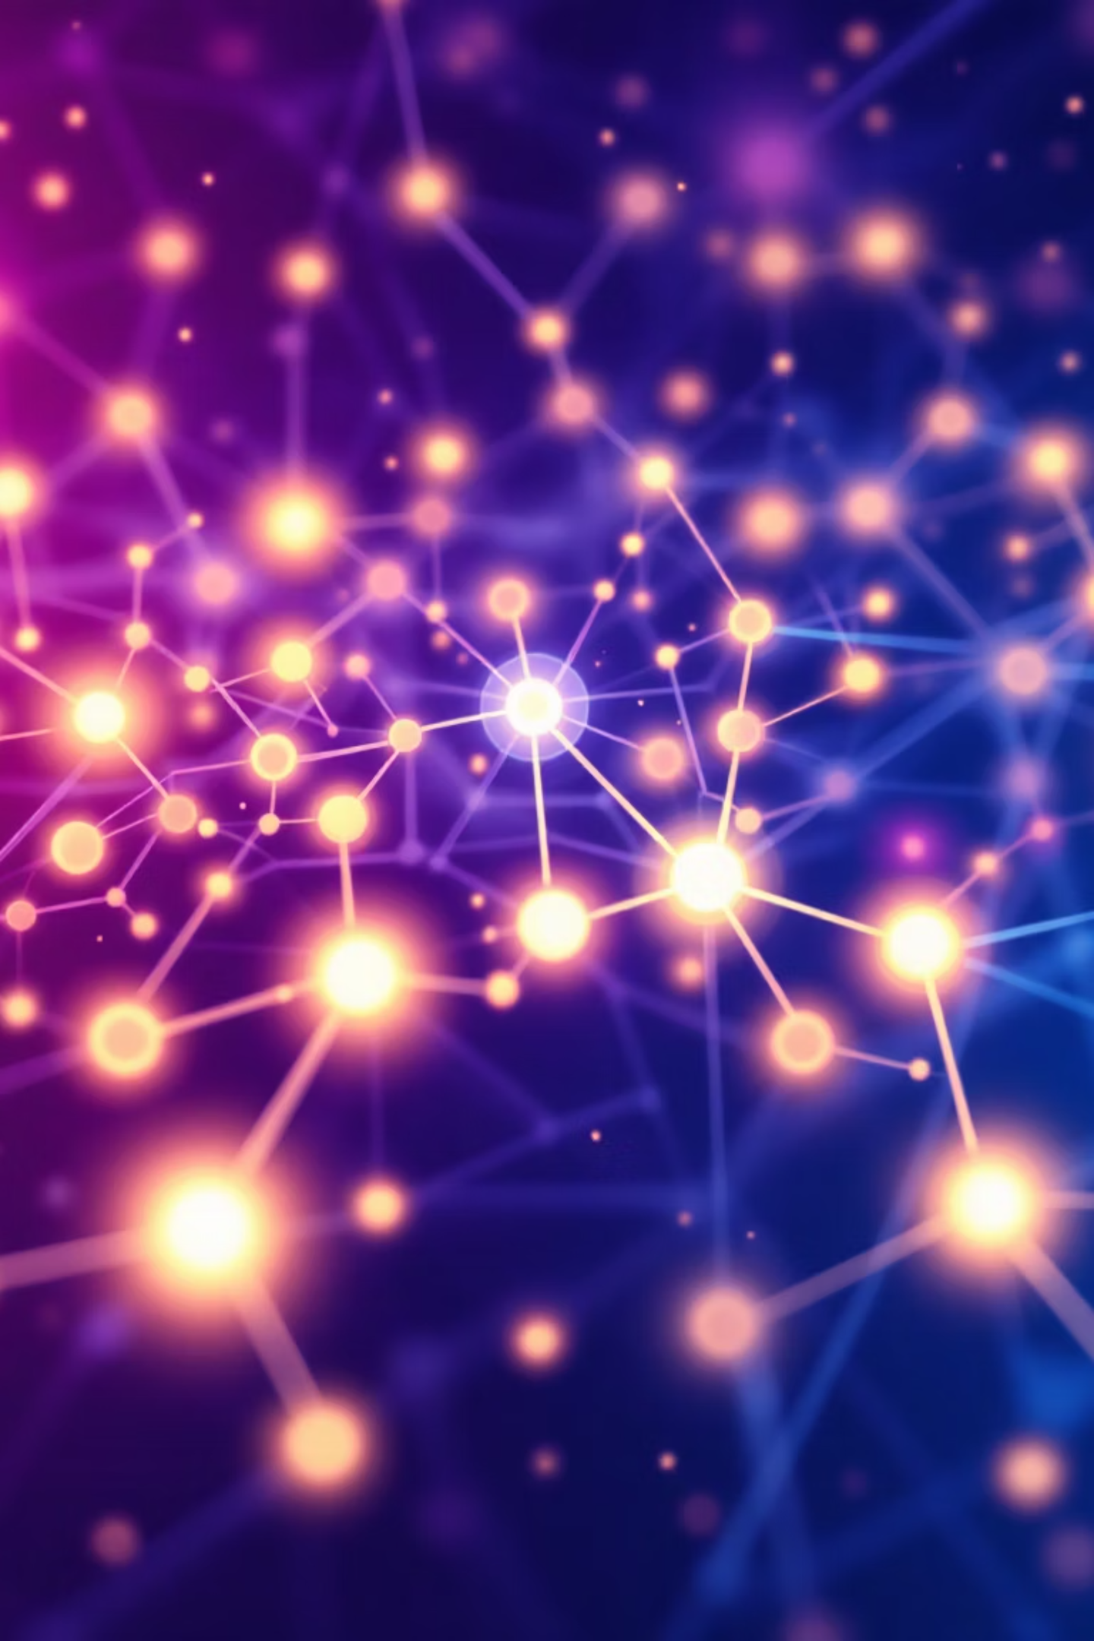
Powering the Future: Key Agentic AI Technologies
The foundation of Agentic AI lies in sophisticated algorithms that enable learning, decision-making, and autonomous operation.
Reinforcement Learning (RL)
AI agents learn optimal behavior by maximizing rewards and minimizing penalties through trial and error in dynamic environments.
Planning Algorithms
These algorithms allow AI to strategize, anticipate outcomes, and choose the most efficient sequence of actions to reach a goal.
Autonomous Systems
Integrate sensors, actuators, and AI to operate independently in the real world, from drones to smart devices.

Slide 7
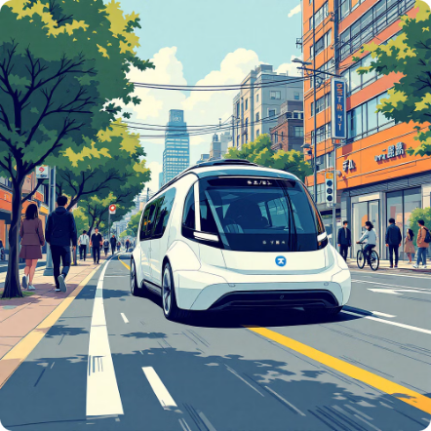
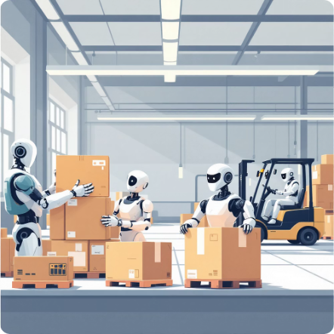

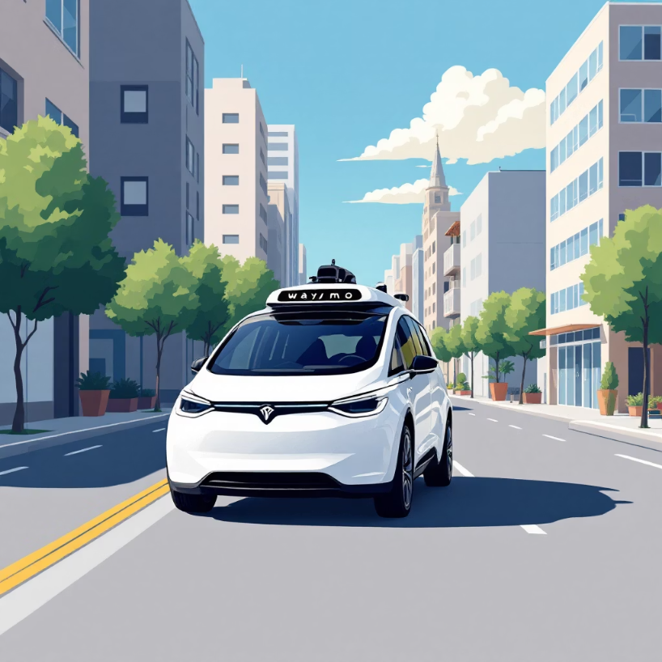

Real-Life Impact: Agentic AI in Action
Case Study: Waymo
Waymo's autonomous vehicles leverage a suite of sensors and AI to plan routes, detect pedestrians, and respond to traffic, making real-time decisions to navigate safely and efficiently.
Transportation
Business & Industry
Self-driving cars and delivery drones autonomously navigate complex environments, transforming logistics and mobility.
Automated trading bots optimize investments, while warehouse robots streamline inventory management and fulfillment.
Smart Homes
Smart thermostats and robotic cleaners manage home environments autonomously, learning user preferences and optimizing energy use.

Slide 8
Navigating the Future: Advantages & Challenges
Advantages
Challenges
Significantly reduces human effort and frees up time for creative tasks.
Can operate in hazardous or extreme environments unsafe for humans.
Makes decisions rapidly and consistently, leading to increased efficiency.
Potential for higher precision and reduced errors in repetitive tasks.
Raises complex safety and ethical dilemmas, especially in critical applications.
Misjudgments or unforeseen errors can lead to severe consequences.
Requires vast amounts of accurate data and sophisticated sensors for reliable operation.
Potential for job displacement and economic disruption.
Would you trust a fully autonomous car today?

Slide 9
The Horizon: Future of Agentic AI
The integration of generative and agentic AI promises a future where machines not only create but also act intelligently and adaptively.
Hybrid AI
Medicine & Healthcare
Research & Discovery
Combining generative capabilities (creation) with agentic autonomy (action) for more comprehensive AI systems.
AI performing complex surgeries, diagnosing conditions, and personalizing treatments autonomously.
AI designing and executing experiments, analyzing data, and discovering new solutions in various scientific fields.
Imagine an AI that can write a research paper and submit it—what are the pros and cons?

Slide 10

Ethics & Responsible AI: Guiding Autonomous Development
As Agentic AI advances, establishing clear ethical guidelines and ensuring responsible development are paramount to its societal integration.
1
Transparency
Ensuring clarity in how AI agents make decisions and achieve their goals.
2
Accountability
Defining responsibility when AI actions lead to unintended consequences or failures.
3
Bias & Fairness
Developing AI systems that are free from inherent biases and treat all individuals equitably.
4
Safety
Implementing robust safeguards to prevent harm to humans and ensure secure operation.
Should Agentic AI have limits or full freedom to act?

